Slide 1
Salary Research based on College Type
Hypothesis : The college you graduated from affects your starting salary and this effect continues for your mid career salary increase

Slide 2
Hypothesis Testing
Post HOC Analysis
Conclusion
H0-College Type does not affect your start salary and salary increase in mid career
HA- There is difference in starting salary based on college type you have graduated from
Performed Tukey HSD Posthoc comparison to Data sets
We have enough evidence to reject null hypothesis and statistically significant difference was found among starting salaries based on different colleges

Slide 3
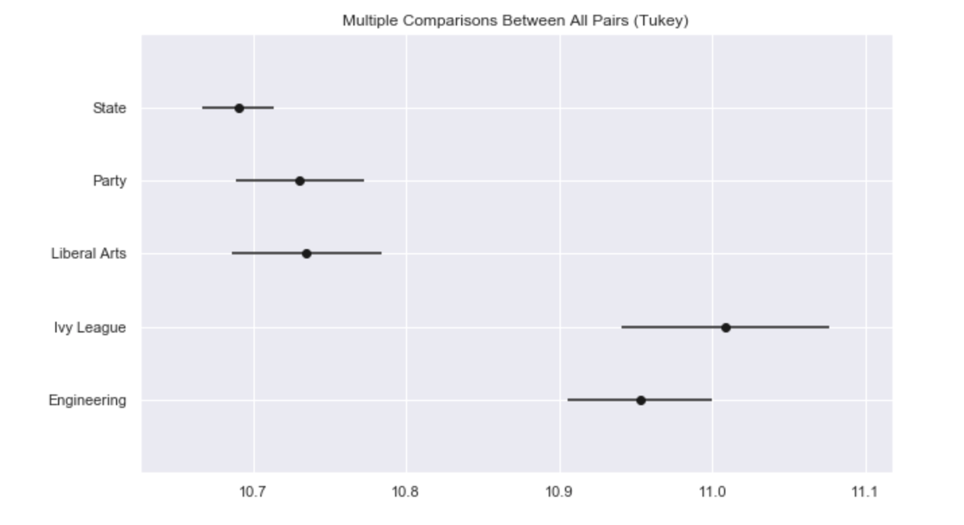
For Starting Median Salary

Slide 4
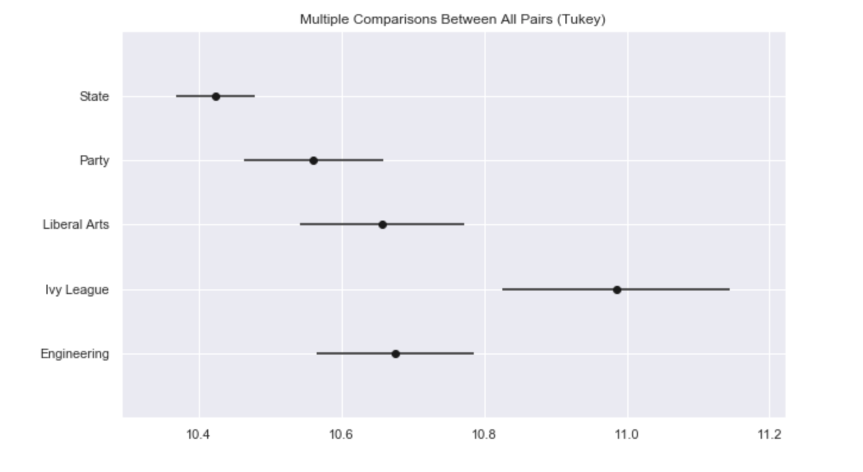
Increase in Salary for Mid Career

Slide 5
Impact
First Part of hypothesis is true. School type you have graduated from has a significant impact on your starting median salary.
Starting Median Salary is not statistically different for IVY league and engineering school type.
Second part of hypothesis is also true .Salary increase in mid career is also significantly affected by school type.
Salary increase in mid career is highest for Ivy League Colleges

